Slide 1


ICRA 2023 Presentation
Self-Improving Safety Performance of Reinforcement Learning Based Driving with Black-Box Verification Algorithms
29 May - 2 June, 2023, ExCel London, UK
Resul Dagdanov, Halil Durmus, and Nazim Kemal Ure
Istanbul Technical University

Slide 2
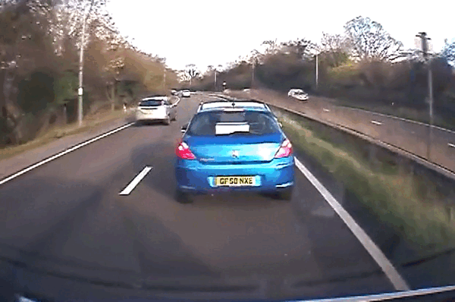
Problem Statement
Decision-making in the safety-critical environments is a challenging problem.
ADAS (advanced driver assistance system) is a trend topic.
Reaction time of the drivers are low.
Computers are faster in decision-making.
Safety-critical scenarios are rare-events.
These scenarios could be generated in the simulation.
Reasons of safety-critical ADAS scenarios:
sudden brakes
people cross the road
animal running
careless drivers
Image Credit: https://gfycat.com/chiefyearlygoat
The IEEE International Conference on Robotics and Automation (IEEE ICRA 2023)
Slide No: 1 / 14

Slide 3
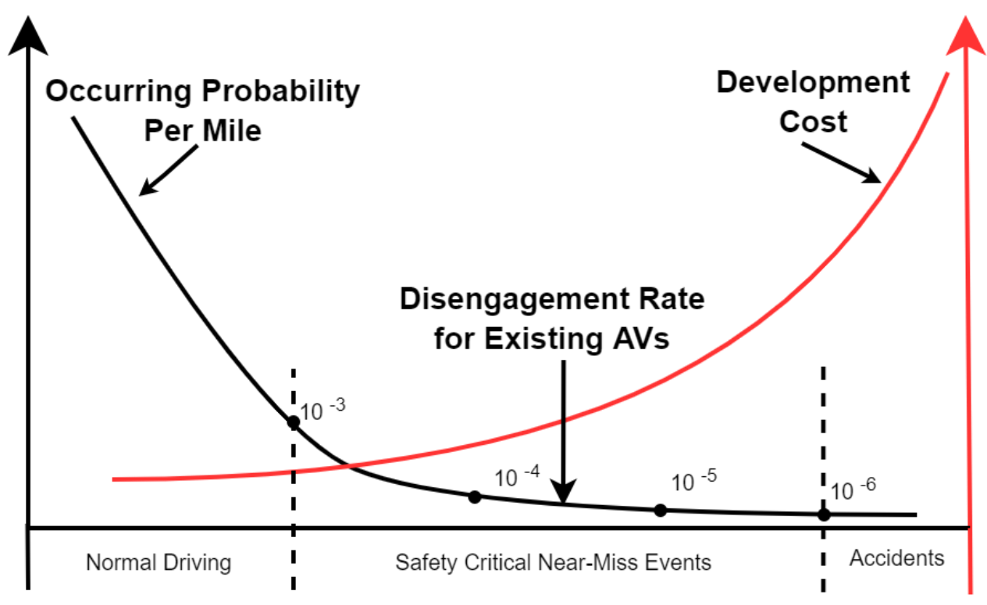
Problem Statement
The probability of observing safety-critical scenarios in real-world is very low.
The amount of data needed grows exponentially with the dimensionality as the probability decreases.
Curse of dimensionality is investigated in:
numerical integration
optimization
machine learning
data mining
Without verification of the model in rare-events, the safety of the black-box AD system could not be guaranteed.
Reference: Liu, Henry X., and Shuo Feng. "" Curse of rarity" for autonomous vehicles." arXiv preprint arXiv:2207.02749 (2022).
The IEEE International Conference on Robotics and Automation (IEEE ICRA 2023)
Slide No: 2 / 14

Slide 4
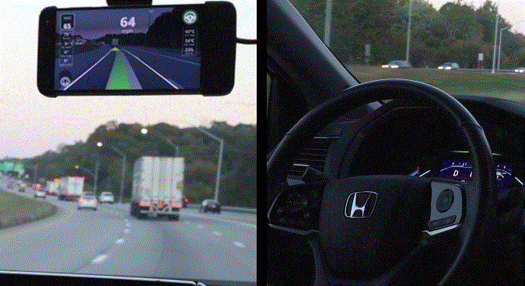
Motivation
Objective is to develop sample efficient, robust, and safe black-box system.
Propose a novel self-improving technique for black-box decision-making and navigation systems.
Investigation of different rare-event simulation techniques for sample efficiency.
Development of a reinforcement learning (RL) agent for decision-making under safety-critical conditions.
Goal is to control the low-level actions of the vehicle.
Adaptive cruise control (ACC) scenarios are studied.
Analyse methods to continuously learn from failures in safety-critical scenario for better robustness.
Leverage power of rare-event simulation into the optimization of a black-box models.
Image Credit: https://comma-ai.medium.com/
The IEEE International Conference on Robotics and Automation (IEEE ICRA 2023)
Slide No: 3 / 14

Slide 5
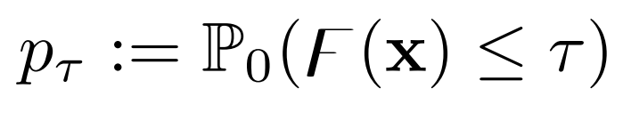
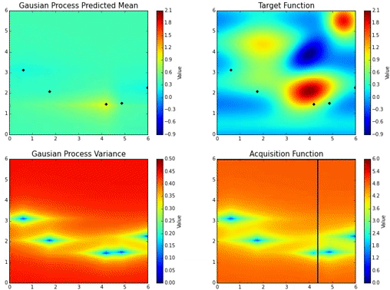
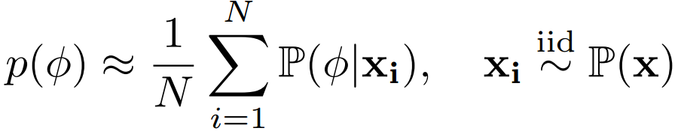
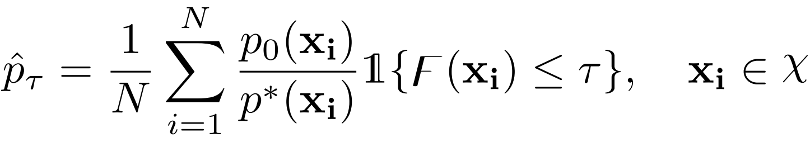
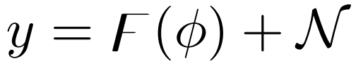
Rare-event Simulation
The probability of the rare-event is defined by the safety function and safety metric.
Naive Monte-Carlo (MC) Sampling:
Cross-Entropy (CE) Search:
Bayesian Optimization (BO) Search:
Image Credit: https://gfycat.com/legalanyantelopegroundsquirrel
Reference: Asmussen, Søren, and Peter W. Glynn. Stochastic simulation: algorithms and analysis. Vol. 57. New York: Springer, 2007.
The IEEE International Conference on Robotics and Automation (IEEE ICRA 2023)
Slide No: 4 / 14

Slide 6
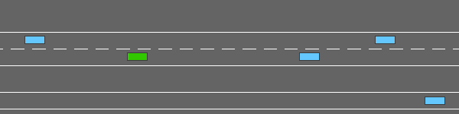
Problem Setting (Environment)
Lightweight 2D simulation environment (Highway-Env) is used for rare-event simulations.
Research gaps:
Exploration and exploitation dilemma is still an active research area.
Lack of safety-critical scenario in the optimization phase of the system could lead to poor generalization.
Existing RL algorithms strongly depend of diversity of training scenarios.
Investigate whether the rare-event assessment and validation samples of the safety-critical system might also be utilized for automatic self-improvement (healing) of the black-box RL agent policies.
Image Credit: E. Leurent, “An environment for autonomous driving decision-making,” https://github.com/eleurent/highway-env, 2018.
The IEEE International Conference on Robotics and Automation (IEEE ICRA 2023)
Slide No: 5 / 14

Slide 7
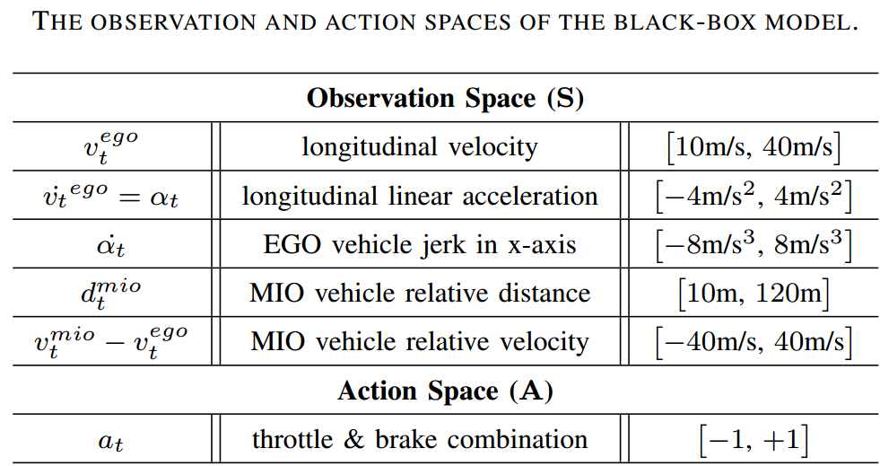
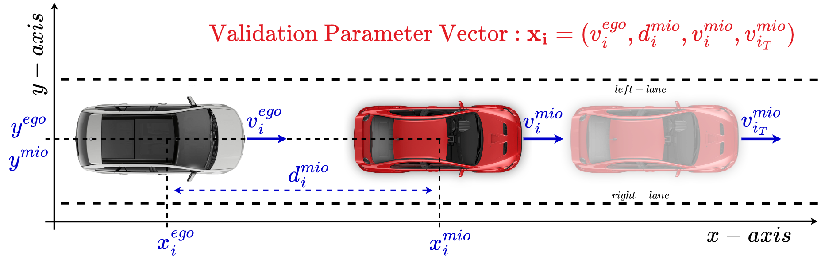
Problem Setting (Parameter Space)
Construction of the Optimization Parameter Vector Space:
MIO: Most Important Object
EGO: Egocentric Vehicle - Agent
The IEEE International Conference on Robotics and Automation (IEEE ICRA 2023)
Slide No: 6 / 14

Slide 8
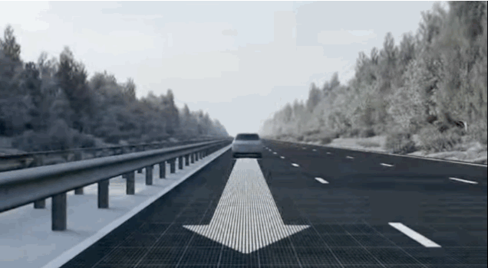
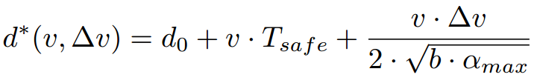
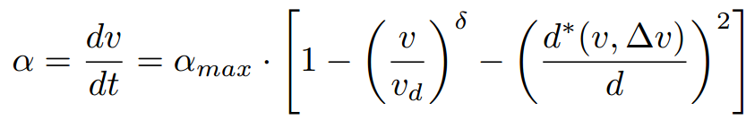
Problem Setting (Front Vehicle)
Intelligent Driver Model (IDM):
The popular model-based action policy for longitudinal acceleration control.
Image Credit: https://gifer.com/en/9fjZ
Reference: Treiber, Martin, Ansgar Hennecke, and Dirk Helbing. "Congested traffic states in empirical observations and microscopic simulations." Physical review E 62.2 (2000): 1805.
The IEEE International Conference on Robotics and Automation (IEEE ICRA 2023)
Slide No: 7 / 14

Slide 9
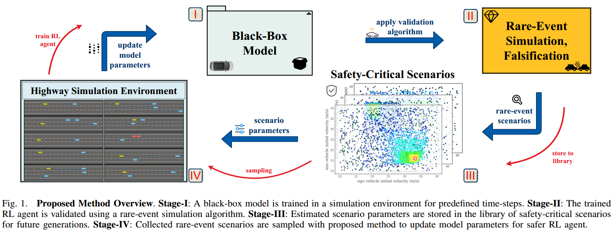
Methodology (Overview)
The IEEE International Conference on Robotics and Automation (IEEE ICRA 2023)
Slide No: 8 / 14

Slide 10
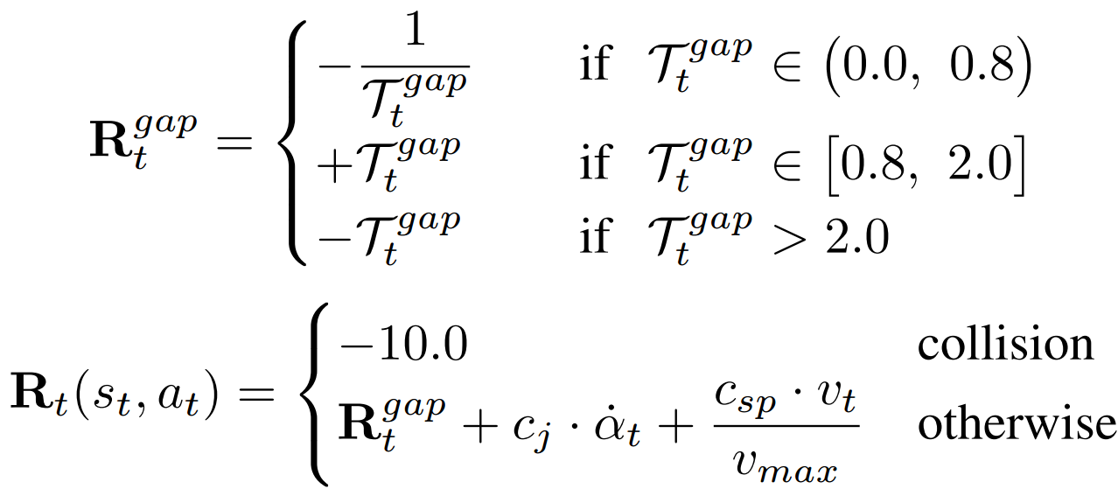
Methodology (Reward Function)
Objective is to follow the front vehicle safety without any collisions.
Significant penalty is given when collision occurs.
Additional penalty coefficient is given for vehicle jerk.
The IEEE International Conference on Robotics and Automation (IEEE ICRA 2023)
Slide No: 9 / 14

Slide 11
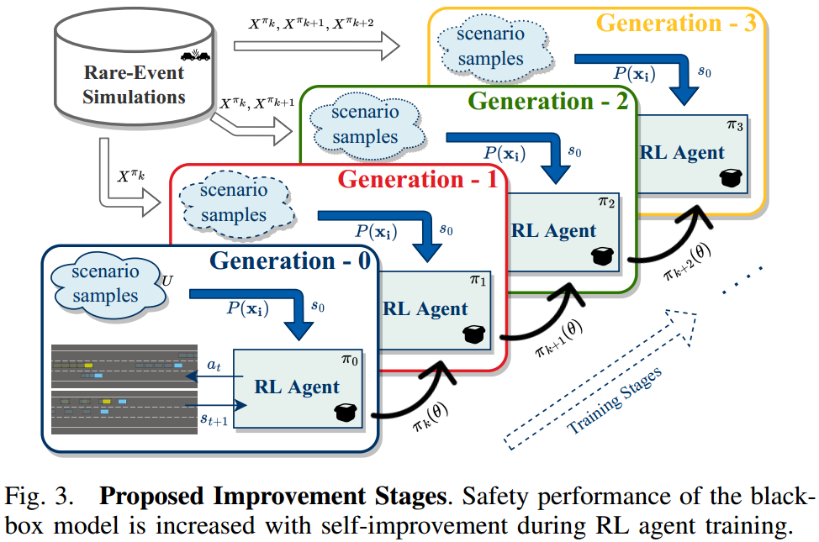
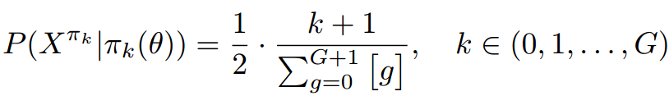
Methodology (Improvement Stages)
Custom sampling probability function:
Sample from the uniform distribution scenarios.
At each training stage, subsequent generation safety-critical scenarios are sampled with higher likelihood.
The IEEE International Conference on Robotics and Automation (IEEE ICRA 2023)
Slide No: 10 / 14

Slide 12
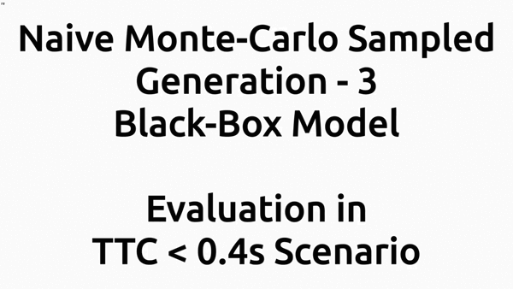
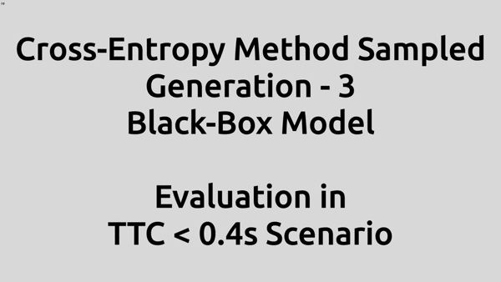
Experiments (MC vs. CE Sampled RL Agents)
Generation-3 black-box model performance in a rare-event safety-critical scenario:
Naive Monte-Carlo (MC) Sampled RL Agent Cross-Entropy (CE) Sampled RL Agent
The IEEE International Conference on Robotics and Automation (IEEE ICRA 2023)
Slide No: 11 / 14

Slide 13
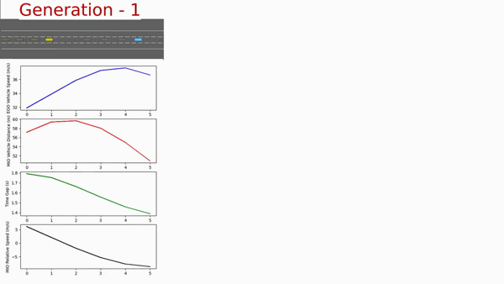
Experiments (Self-Improving Generations)
The IEEE International Conference on Robotics and Automation (IEEE ICRA 2023)
Slide No: 12 / 14

Slide 14
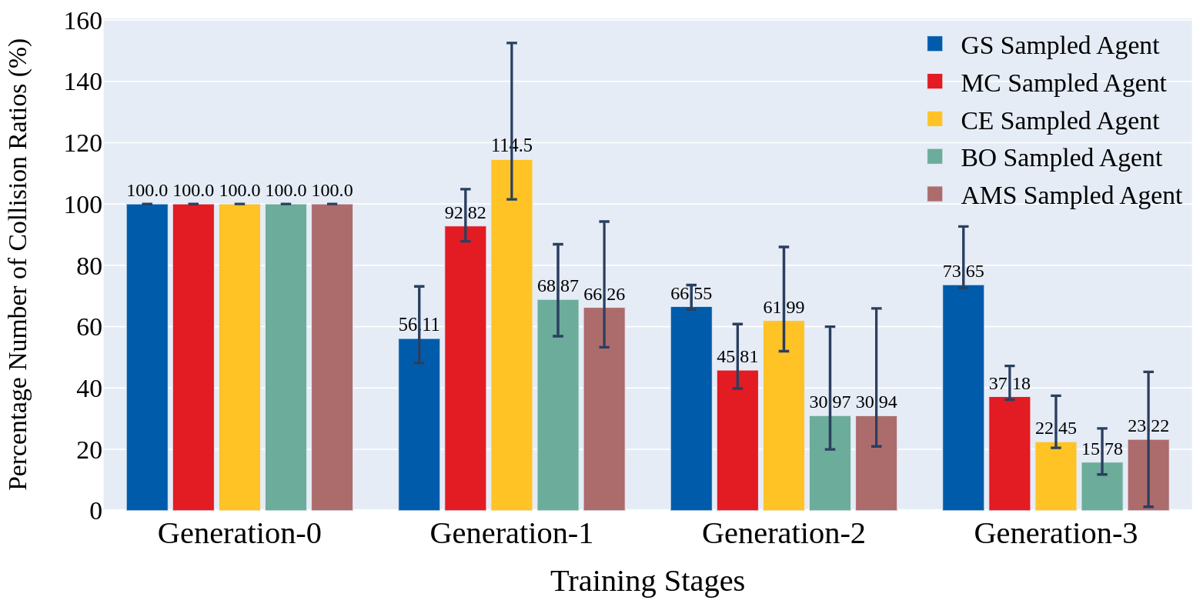
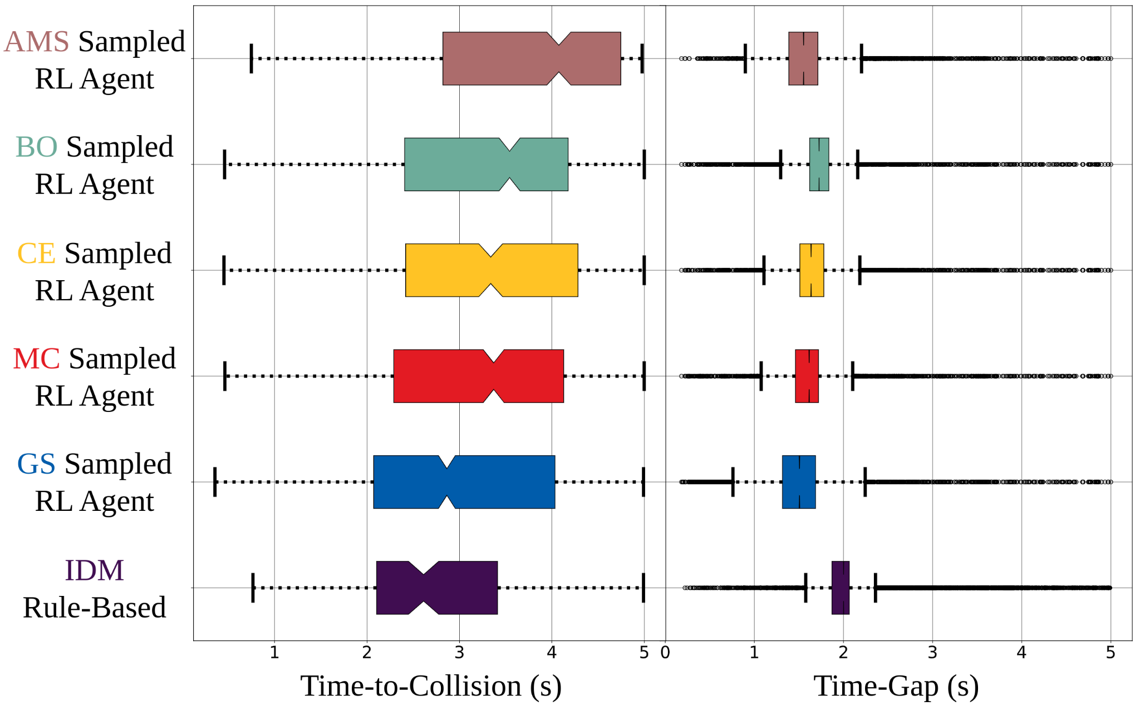
Results
The IEEE International Conference on Robotics and Automation (IEEE ICRA 2023)
Slide No: 13 / 14

Slide 15
Conclusion and Future Work
Proposed a novel self-improving framework using black-box verification algorithms.
Developed a safety-enhanced reinforcement learning autonomous driving policy.
Safety-critical scenarios are detected at early stages of the training and successfully leveraged rare scenarios.
Future goal is to expand this method to higher-dimensional scenario vector space problems.
Different sampling techniques from rare-event simulation data will be deeply examined.
Lane-changing control will be investigated within the proposed self-improving methodology.
The IEEE International Conference on Robotics and Automation (IEEE ICRA 2023)
Slide No: 14 / 14

